Slide 1
Intelligent System
Informed Search
Nunung Nurul Qomariyah
nunung.qomariyah@binus.edu

Slide 2
Session Learning Outcomes
Upon completion of this session, students are expected to be able to
LO 2 Understand different approaches and techniques in AI.
LO 3 Understand basic mathematical background used in AI.
LO 4 Apply appropriate computing and mathematical techniques in AI case.

Slide 3
Outline
Best-First search
A* search
Heuristics

Slide 4
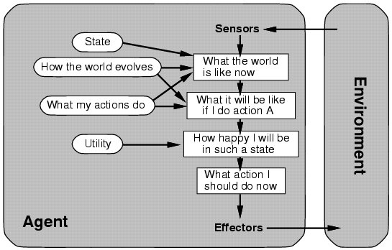
Utility-Based Agent

Slide 5
Informed Search
Informed searches use domain knowledge to guide selection of the best path to continue searching.
Use heuristics, that is, use informed guesses.
Heuristic: a technique to solve a problem faster by using a rule of thumb, an intuitive judgment, or common sense.

Slide 6
Heuristic Function
A heuristic function, h(n):
uses domain-specific information in some way
is computable from the current state description
estimates the goodness of node n
estimates how close to a goal is node n
estimates the minimal cost of the path from node n to a goal state

Slide 7
Heuristic Function (2)
h(n) ≥ 0 for all nodes n
h(n) = 0 implies that n is a goal node
h(n) = ∞ implies that n is a dead end from which a goal cannot be reached
All domain knowledge used in the search is encoded in the heuristic function h.
This is an example of a weak method because of the limited way that domain-specific information is used to solve a problem.

Slide 8
Best-First Search
Idea: tries to expand most desirable unexpanded nodes.
Sort nodes in the nodes list by increasing values of an evaluation function f(n) that incorporates domain-specific information.
This is a generic way of referring to the class of informed search methods:
Greedy search
A* search

Slide 9
Greedy Search
Use as an evaluation function f(n) = h(n), sorting nodes in the nodes list by increasing values of f.
Selects the node to expand that is believed to be closest (i.e. smallest f value) to a goal node.
Example: For route-finding task, the straight-line distance heuristic is typically used.

Slide 10
Greedy Search Example
f(n) = h(n)
# of nodes tested=0, expanded=0
S
h=8
1
8
expnd. node
OPEN list
5
{S:8}
A
h=8
B
h=4
C
h=3
3
7
4
9
5
D
h=∞
E
h=∞
G
h=0

Slide 11
Greedy Search Example (2)
f(n) = h(n)
# of nodes tested=1, expanded=1
S
h=8
1
8
expnd. node
OPEN list
5
{S:8}
A
h=8
B
h=4
C
h=3
S not goal
{C:3,B:4,A:8}
3
7
4
9
5
D
h=∞
E
h=∞
G
h=0

Slide 12
Greedy Search Example (3)
f(n) = h(n)
# of nodes tested=2, expanded=2
S
h=8
1
8
expnd. node
OPEN list
5
{S:8}
A
h=8
B
h=4
C
h=3
S not goal
{C:3,B:4,A:8}
3
7
4
C not goal
{G:0,B:4,A:8}
9
5
D
h=∞
E
h=∞
G
h=0

Slide 13
Greedy Search Example (4)
f(n) = h(n)
# of nodes tested=3, expanded=2
S
h=8
1
8
expnd. node
OPEN list
5
{S:8}
A
h=8
B
h=4
C
h=3
S not goal
{C:3,B:4,A:8}
3
7
4
C not goal
{G:0,B:4,A:8}
9
5
G is goal
{B:4,A:8}
D
h=∞
E
h=∞
G
h=0
• Fast but not optimal.
Path: S, C, G
Cost: 13

Slide 14
Greedy Search Evaluation
Not complete
If trapped in an infinite path or loops.
Not optimal/admissible
Greedy search finds the left goal (solution cost: 7)
Optimal solution is the path to the right goal (solution cost: 5)
The worst case time complexity = space complexity = O(b^{m}),
m: maximum depth of the search space.
S
h=5
2
2
A
h=3
B
h=4
1
2
C
h=3
D
h=1
1
1
E
h=2
G
goal
3
G
goal

Slide 15
Beam Search
Use an evaluation function f(n) = h(n) as in greedy search, but restrict the maximum size of the nodes list to a constant k.s
Only keep k best nodes as candidates for expansion, and throw away the rest.
More space efficient than Greedy Search, but may throw away a node on a solution path.
Not complete.
Not optimal/admissible.

Slide 16
A Search Algorithm
Use evaluation function f(n) = g(n) + h(n), where
g(n) is path cost from start to current node n (as defined in Uniform-Cost search).
h(n) is the estimated cost from node n to goal
f(n) is the estimated cost of a solution through n to goal
Nodes on the search frontier (in nodes list) are ranked by the estimated cost of a solution f(n).

Slide 17
A Search Algorithm (2)
Not complete
Not optimal / admissible
Algorithm A Search never expands E because h(E) = ∞
What’s the problem?
S
h=6
S
h=7
2
2
1
2
A
h=3
B
h=4
A
h=7
B
h=4
2
2
1
2
C
h=2
D
h=1
C
h=5
D
h=3
1
1
1
1
E
h= ∞
F
h=90
E
h= 3
F
h=2
2
99
1
G
h=0
G
h=0

Slide 18
A* Search Algorithm
Uses the same evaluation function as used by Algorithm A search, except adds the constraint that:
For all nodes n in the search space, h(n) ≤ h*(n), where h*(n) is the true cost of the minimal cost path from n to a goal.
When h(n) ≤ h*(n) holds for all n, then h is admissible,
i.e., it never overestimates the cost to the nearest goal.
An admissible heuristic guarantees that a node on the optimal path can never look so bad to be not considered.
E.g. straight-line heuristic.

Slide 19
A* Search Algorithm (2)
Complete
whenever the branching is finite, and every operator has a fixed positive cost.
Optimal.
Admissible: for every node n, h(n) ≤ actual cost from node n to the goal.
Consistent (monotonic): for every node n and every successor of n (n’): h(n) ≤ h(n’) + c(n, n’), where c(n, n') is step cost from n to n'
S
h=5
3
3
A
h=1
B
h=∞
2
C
h=0

Slide 20
A* Search Algorithm (2)
Time complexity:
exponential in [relative error in h * length of solution].
Space complexity:
O(b^{m}), where m: the maximum depth of the search space.
S
h=5
3
2
A
h=2
B
h=1
2
2
C
h=0
D
h= ∞

Slide 21
A* Search Example
n
h(n)
g(n)
f(n)
h*(n)
S
h=8
S
8
1
8
5
A
8
A
h=8
B
h=4
C
h=3
B
4
C
3
3
7
4
9
5
D
∞
D
h=∞
E
h=∞
G
h=0
E
∞
G
0
h(n): estimated cost to get to goal from node n.

Slide 22
A* Search Example (2)
n
h(n)
g(n)
f(n)
h*(n)
S
h=8
S
8
0
1
8
5
A
8
1
A
h=8
B
h=4
C
h=3
B
4
5
C
3
8
3
7
4
9
5
D
∞
4
D
h=∞
E
h=∞
G
h=0
E
∞
8
G
0
10/9/13
g(n): actual cost to get to node n from start. (travel distance so far)

Slide 23
A* Search Example (3)
n
h(n)
g(n)
f(n)
h*(n)
S
h=8
S
8
0
8
1
8
5
A
8
1
9
A
h=8
B
h=4
C
h=3
B
4
5
9
C
3
8
11
3
7
4
9
5
D
∞
4
∞
D
h=∞
E
h=∞
G
h=0
E
∞
8
∞
G
0
10/9/13
10/9/13
f(n) = g(n) + h(n): actual cost to get from start to node n
plus estimated cost to get to goal from node n.

Slide 24
A* Search Example (4)
n
h(n)
g(n)
f(n)
h*(n)
S
h=8
S
8
0
8
9
1
8
5
A
8
1
9
9
A
h=8
B
h=4
C
h=3
B
4
5
9
4
C
3
8
11
5
3
7
4
9
5
D
∞
4
∞
∞
D
h=∞
E
h=∞
G
h=0
E
∞
8
∞
∞
G
0
10/9/13
10/9/13
0
h*(n) : true cost of minimal path from node n to goal.
Is h(n) admissible?

Slide 25
A* Search Example (5)
n
h(n)
g(n)
f(n)
h*(n)
S
h=8
S
8
0
8
9
1
8
5
A
8
1
9
9
A
h=8
B
h=4
C
h=3
B
4
5
9
4
C
3
8
11
5
3
7
4
9
5
D
∞
4
∞
∞
D
h=∞
E
h=∞
G
h=0
E
∞
8
∞
∞
G
0
10/9/13
10/9/13
0
Since h(n) ≤ h*(n) for all n, h is admissible.

Slide 26
A* Algorithm
1. Put the start node S in the nodes list, called OPEN
2. If OPEN is empty then exit with failure
3. Remove from OPEN the node n for which f(n) is minimum and place it in CLOSED, a list of expanded nodes
4. If n is a goal node then exit (for solution path: trace back links from n to S)
5. Expand n, generating all its successors and store in them a link back to n … (cont.)

Slide 27
A* Algorithm (2)
5. Expand n, generating all its successors and store in them a link back to n.
For each successor node n' of n
If n' is not already in either OPEN or CLOSED, estimate: - h(n'),
- g(n') = g(n) + c(n,n'), where c(n,n') is step cost from n to n'
- f(n') = g(n') + h(n'), and place it in OPEN
b) If n' is already in either OPEN or CLOSED,
Check if g(n') is lower for the newly generated n'
i. If it is not lower, do nothing
ii. If it is lower, replace existing g(n') at n' with new g(n'), link back to this n
6. Go to 2

Slide 28
A* Algorithm Example
f(n) = g(n) + h(n)
# of nodes tested=0, expanded=0
S
h=8
1
8
expnd. node
OPEN list
5
{S:0+8}
A
h=8
B
h=4
C
h=3
3
7
4
9
5
D
h=∞
E
h=∞
G
h=0

Slide 29
A* Algorithm Example (2)
f(n) = g(n) + h(n)
# of nodes tested=1, expanded=1
S
h=8
1
8
expnd. node
OPEN list
5
{S:0+8}
A
h=8
B
h=4
C
h=3
S not goal
{A:1+8,B:5+4,C:8+3}
3
7
4
9
5
D
h=∞
E
h=∞
G
h=0

Slide 30
A* Algorithm Example (3)
f(n) = g(n) + h(n)
# of nodes tested=2, expanded=2
S
h=8
1
8
expnd. node
OPEN list
5
{S:0+8}
A
h=8
B
h=4
C
h=3
S not goal
{A:9,B:9,C:11}
{B:9,G:1+9+0,C:11,
D:1+3+∞,E:1+7+∞}
3
7
4
A not goal
9
5
D
h=∞
E
h=∞
G
h=0

Slide 31
A* Search Example (4)
f(n) = g(n) + h(n)
# of nodes tested=3, expanded=3
S
h=8
1
8
expnd. node
OPEN list
5
{S:0+8}
A
h=8
B
h=4
C
h=3
S not goal
{A:9,B:9,C:11}
A not goal
{B:9,G:10,C:11,D:∞,E:∞}
3
7
4
9
5
{G:5+4+0,G:10,C:11,
D:∞,E:∞}
D
h=∞
E
h=∞
G
h=0
B not goal
• There are two G nodes;
choose the one with a lower g(n) or f(n) value.

Slide 32
A* Search Example (5)
f(n) = g(n) + h(n)
# of nodes tested=4, expanded=3
S
h=8
1
8
expnd. node
OPEN list
5
{S:0+8}
A
h=8
B
h=4
C
h=3
S not goal
{A:9,B:9,C:11}
A not goal
{B:9,G:10,C:11,D:∞,E:∞}
3
7
4
9
5
B not goal
{G:9, C:11,D:∞,E:∞}
D
h=∞
E
h=∞
G
h=0
G is goal
{C:11,D:∞,E:∞}
• Fast and optimal.
Path: S, B, G
Cost: 9

Slide 33
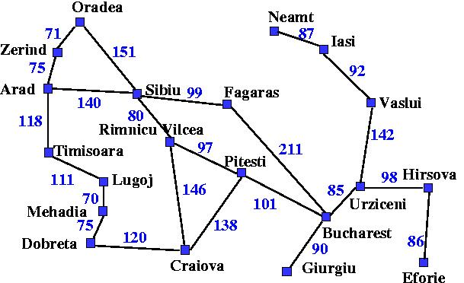
Exercise:
Given the map as in the picture, the heuristics are defined as straight line distances between two places shown in the red text.
Find the path from Arad to Bucharest, using:
Greedy Best First Search
A* algorithm
380
234
374
226
366
253
176
199
193
329
244
100
80
151
241
0
242
160
77
161

Slide 34
References
Russell, S..J. ,& Norvig, P. (2010). Artificial intelligence: A Modern Approach (3rd Ed.). New York: Pearson. ISBN: 860-1419506989

